Slide 1
Fourier Transform & Fast Fourier Transform
Yue Shi
Credit to Xintong Zhu and Yuanfan Wang

Slide 2
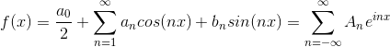
Fourier Analysis
For any periodic function f(x), we can decompose the function using a sequence of cos and sin functions. For f(x) that has a period of 2 pi, we can decompose it as the following:
And we can calculate all the coefficients simply by multiplying the corresponding sin or cos function and then do an integration as they are all orthogonal pairwise(integration of cosnx*cosmx=0 if n!=m).

Slide 3
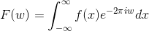
Fourier Transform
Even if the function/signal and it is no longer periodic, we can still decompose it,
The Fourier transform (FT) decomposes (also called analysis) a function of time (a signal) into its constituent frequencies.
As the above equation shows, we can transform any function f(x) to a function of w(frequency) F(w). F(w) is actually the different coefficients (An) shown in the last slides.

Slide 4
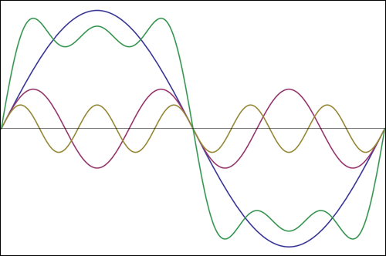
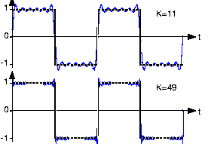
Example of Fourier Decomposition
Here is an example of decomposing a square wave:
We observe that the more k we have, the more accurate approximation of the function we get. This is a good way to approximate functions as we can store the first few coefficients and then we would get a function that is really close to the original one

Slide 5
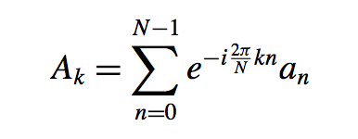
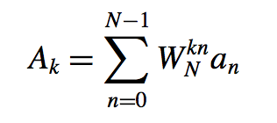
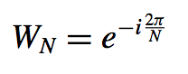
Discrete Fourier Transform
We can use the discrete Fourier transform, or DFT to compute fourier transform by computers. Suppose we have a periodic signal of length N. We construct a_{n} for n = 0 … N - 1. (a_{n} =f(n)) The discrete Fourier transform of a_{n} is:
This is more commonly written:
where
This is just an approximation to the original function, as shown in the previous slide. (This is how we store audios)
Notes:
P

Slide 6
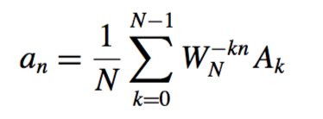
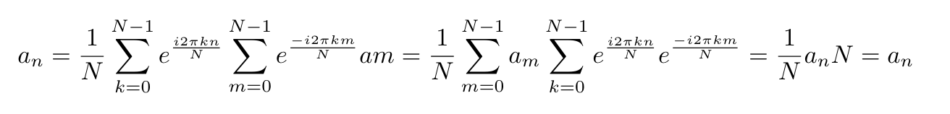
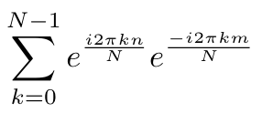
Inverse discrete Fourier transform
Given the coefficients, we can also find the original function.
The sequence a_{n} is the inverse discrete Fourier transform of the sequence A_{k}. The formula for the inverse DFT is
Check pretty straight forward
See each as an inner product, and takes N only when m = n.

Slide 7
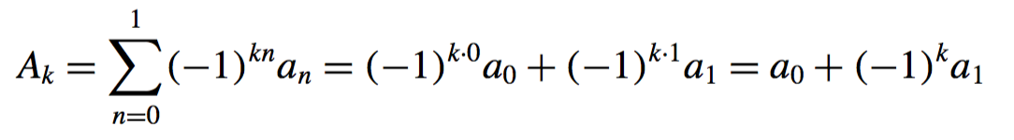
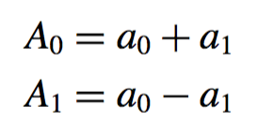
Example of Discrete Fourier Transform
We can see {a_{n} } as discrete points on original functions and {A_{k} } as discrete points on its Fourier transform.
For example, when N = 2, W₂ = e^{-iπ} = -1, and
So

Slide 8
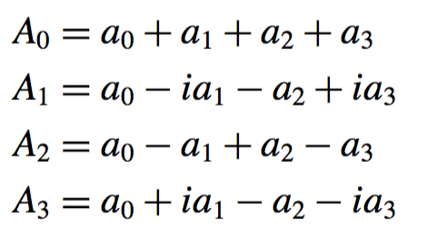
Example of Discrete Fourier Transform
When N = 4, W₄ = e^{-iπ / 2} = -i, and
So

Slide 9
Discrete Fourier Transform (cont.)
The problem to minimize the amount of time to calculate efficiently the discrete Fourier transform arises naturally in numerical analysis.
We begin a naive approach to the problem. Fix N, and suppose that we are given a₀, a₁, … , a_{N-1}. Then the time complexity is O(N²)

Slide 10
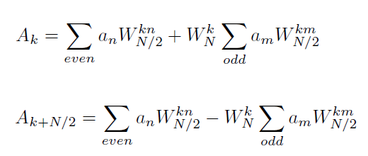
FFT Algorithm - Cooley & Tukey (1965)
Divide and Conquer
Assume N is a power of 2
Divide the problem into 2 subproblems: input with even indices and input with odd indices
Recursively compute FFT for N/2 inputs, and add back to get FFT for N inputs
Notes:
I have the proof of the above equation but I might not go over it.

Slide 11
FFT Time Complexity (# of operations)
n = 8
Assume it takes O(n) to solve a
problem of size n from its subproblem
At level j, # of operation is:
O(2^{j}(n/2^{j})) = O(n)
There are log₂n levels
So total # of operations is O(n log₂n).
(With the help of Quantum computers, we can even make FFT in O(logn))
n/2
n/2
n/4
n/4
n/4
n/4
n/8
n/8
n/8
n/8
n/8
n/8
n/8
n/8
Recursion Relation: T(n) = 2T(n/2) + O(n)

Slide 12
FFT Recursion Tree and Relation
Pseudocode based on Rec Tree
a0,a1,a2,a3,a4,a5,a6,a7
Input: a[0], a[1],… a[n-1]
Output: b[0], b[1], …b[n-1]
FFT (a[0], a[1], …, a[n-1], n):
If n == 1
return a[0];
Else
(c[0], …c[n/2 – 1]) = FFT (a[0], a[2], …, a[n-2], n/2)
(d[0], …d[n/2 – 1]) = FFT (a[1], a[3], …, a[n-1], n/2)
for k = 1, 2, … n/2 – 1
b[k] = c[k] + W^{k} d[k]
b[n/2 + k] = c[k] - W^{k} d[k]
return (b[0], b[1],… b[n-1])
a0,a2,a4,a6
a1,a3,a5,a7
a0,a4
a2,a6
a1,a5
a3,a7
a0
a4
a2
a6
a1
a5
a3
a7

Slide 13
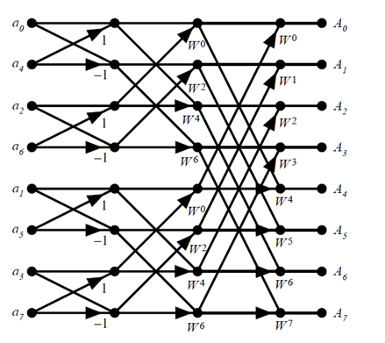
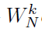
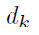
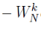
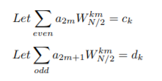
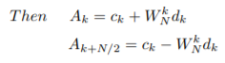
FFT Butterfly Representation
Illustration:

Slide 14
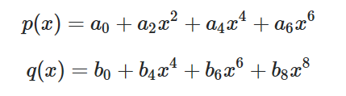
Application of FFT: Polynomial Multiplication
Besides storing music and pictures, we can also use FFT on some other applications. One can be polynomial multiplication:
Given two polynomials:
We can compute them in O(nlogn) using FFT instead of O(n^2)

Slide 15
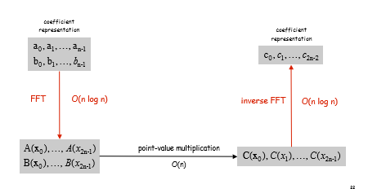
Polynomial Multiplication
Here is the steps:
Express the coefficients of f and g in terms two vectors a and b
Do the FFT of f and g and store them as another two vectors A and B
The multiplication of the new coefficients C = A_i*B_i
Then do the inverse FFT and get vector c, which is the coefficients of the desired function
Notes:
I also have the math proof but I might not go over it,

Slide 16
Application of FFT: CMB and Power Spectrum
First, what is CMB?
CMB stands for cosmic microwave background (radiation). It is the radiation as a remnant from an early stage of the universe after inflation. The CMB is the oldest and cleanest source of information in the early universe.
Notes:
I will just show the final results to say that FFT can help us understand the signal and find the patterns better.
With all these huge data, we can now decompose the data and hope to find something interesting. I am going to introduce you guys some of such applications in the field of cosmology, where people decompose huge amount of data to answer some of the most fundamental questions about our universe. In particular, I am going to talk about the famous CMB, cosmic microwave background radiation. The CMB has helped cosmologists to explore and understand what is our early universe like and I will talk about some of its implication on our universe that is understood with the help of fourier decomposition. So let’s first introduce CMB.

Slide 17
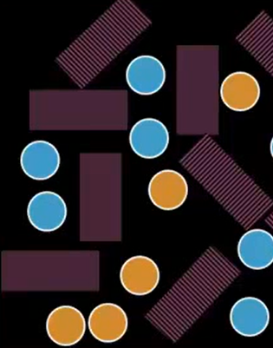
Where does CMB come from?
Big Bang and Inflation:
Our universe is created by the big bang:
It is believed that the size of the universe increases by a factor of 10^23 during 10^-34 seconds (inflation), and then the universe keeps expanding (but less less slowly) and gradually cools down.
the temperature falls below 3000K (about 380,000 years after Big Bang); neutron atom (hydrogen) is formed, before that we only have ionized particles
CMB is formed as a result of this transition
Ionized particles are opaque (trap photons) (as illustrated by the above fig)
When the universe cools down, neutral particles formed, which are transparent. Then the photons leak out.
Notes:
And this process is what created the CMB

Slide 18
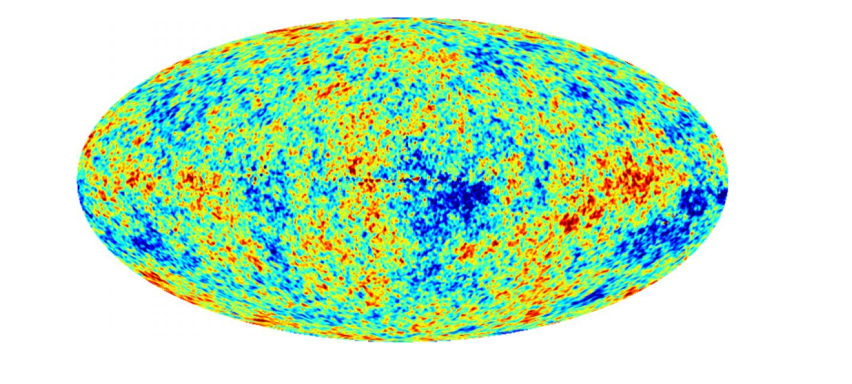
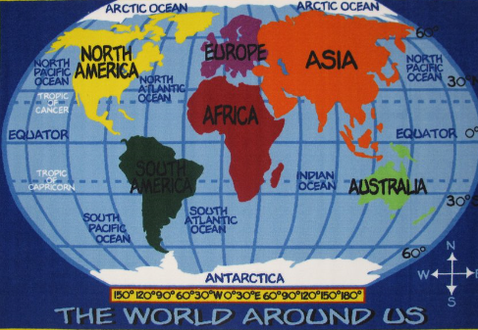
What can we do with CMB
We now detect the CMB. Getting rid of the instrumental noises and the red/blue shift due to the movement of our location (as the universe is still expanding), we end up with something like this:
Just something like the map of the world
Notes:
As we now understand where does CMB come from. We can detect it by some fancy antena and do some analysis on it. But first, we have to do some sort of data cleaning,
CMB Temp has an inverse relation to the density of universe
Our universe nowadays definitely does not have the same density everywhere.

Slide 19
Power Spectrum
We will try to decompose the signal we observed by Fourier transform and look at its coefficients with different frequencies.
We can define a function P(k) = |a_{k} ²| for a_{k} is the fourier coefficients of some frequency k.
P(k) is referred as the power spectrum and it has a lot of uses and implications on cosmology.
Notes:
Now we are going to apply some fourier tricks on the data and try to get some more meaningful physics info. But first we have to introduce some of the terms to understand what comologists are doing.

Slide 20
Spherical Harmonics
For the CMB, as the signal is not on a plane but rather a sphere, we can decompose it in some other way to get more meaningful physics implication.
We will use spherical harmonics function Y_{(l, m)} (which is also a complete orthogonal basis in l2), as we know the wavelength of a wave λ~2π/l
Now we will look at how do we get Y_{(l, m)}
Notes:
We are going to pcik some other orthongonal basis, called sphercal harmonics.
And also to introduce some properties for l and m

Slide 21
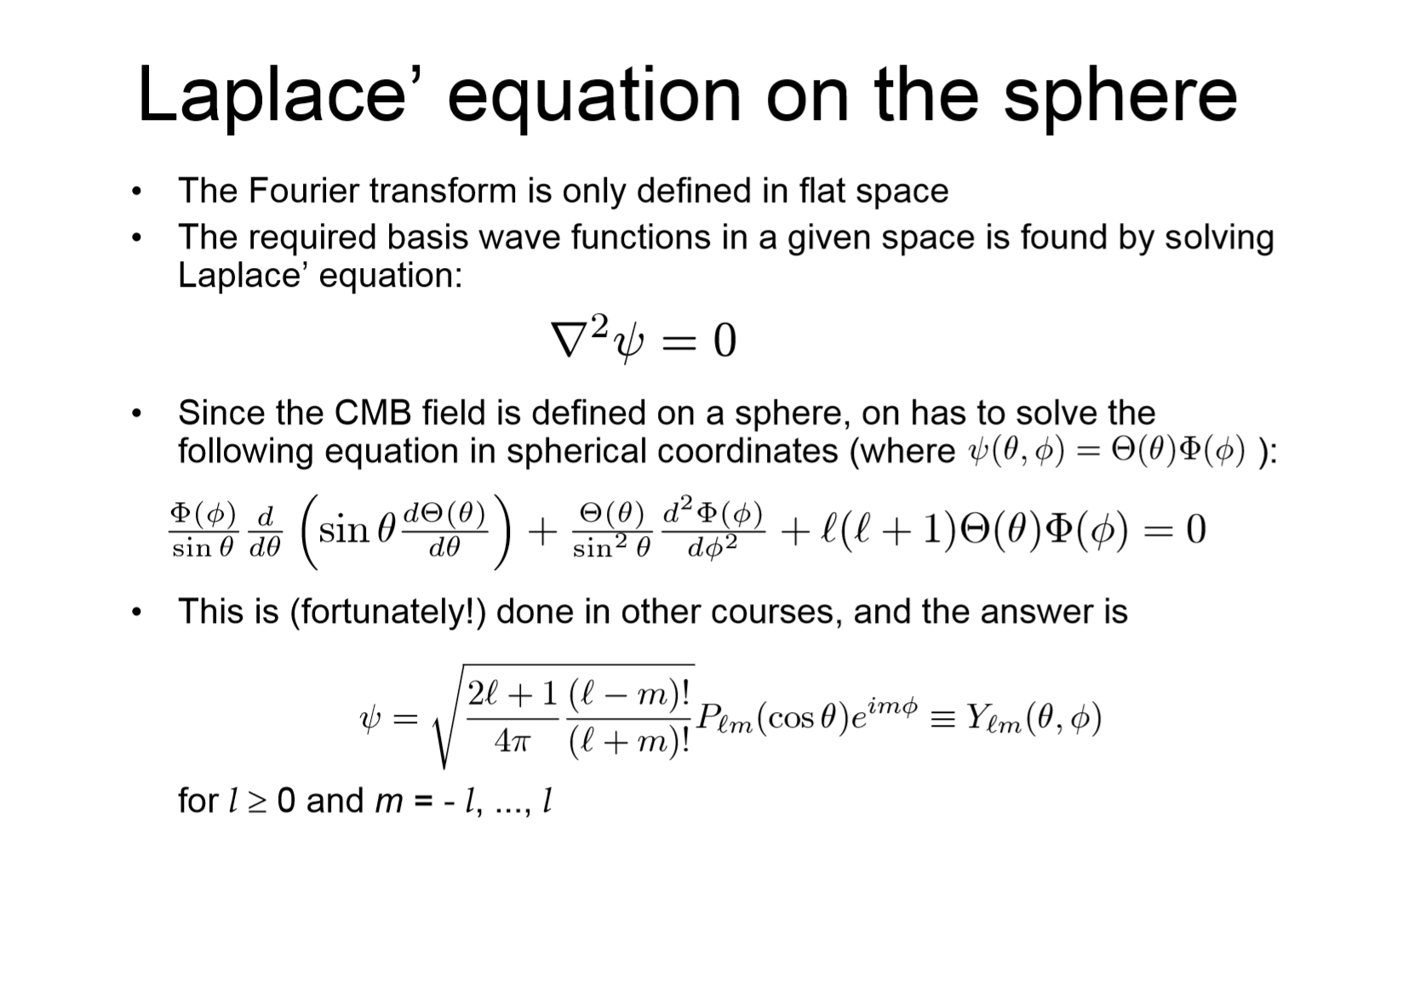
Notes:
Root of this laplacian.

Slide 22
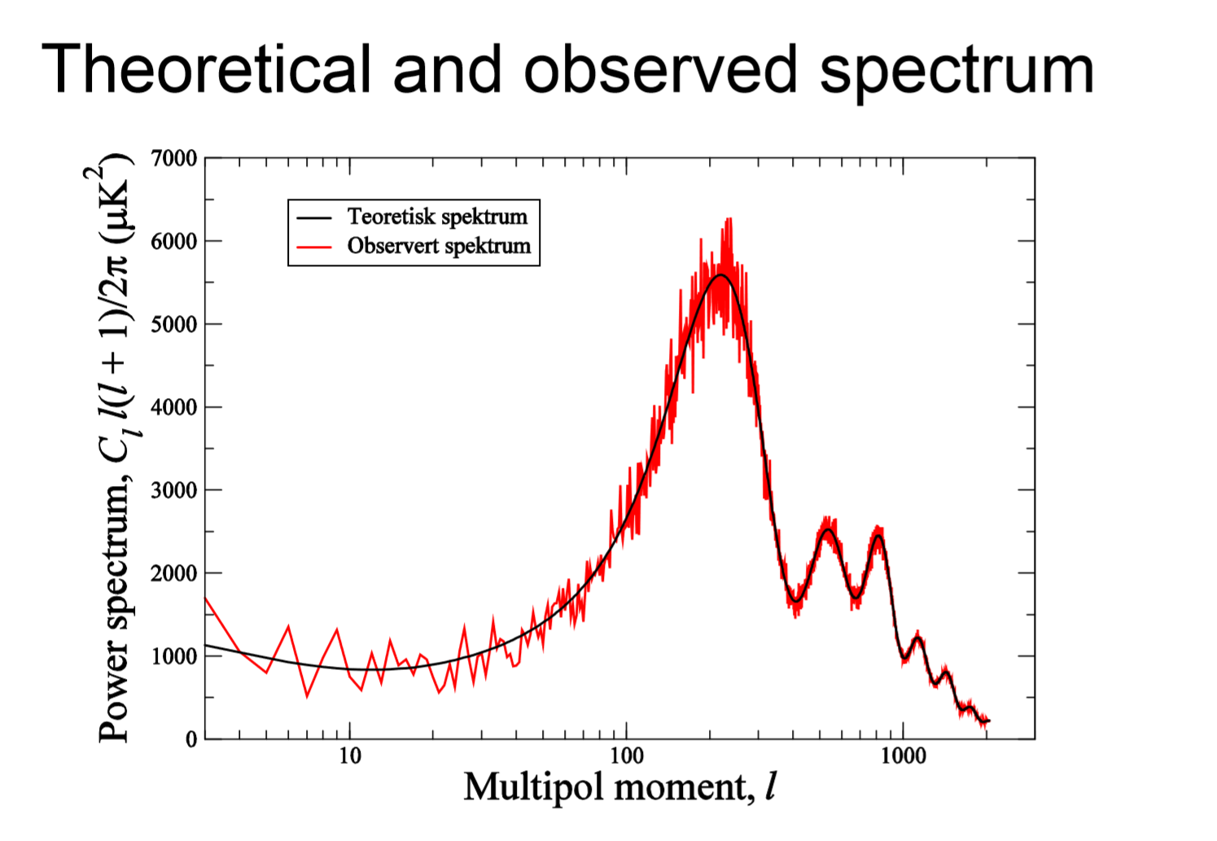
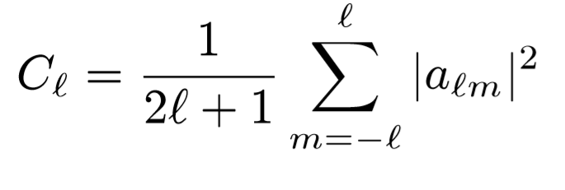
Angular Power Spectrum
We can define a function P(l) to be the average of all the spherical harmonics transform coefficients a _{(l, m)} with regard to some specific l.
Thus we decompose the signal and get the angular power spectrum:
Notes:
This graph is much more informative less less noisy then the previous temperature graph and it is definitey telling us something about the early universe. But what is this information? I am going to try my best to explain it.

Slide 23
Quantum Fluctuation
Before inflation as the universe is small, the density of the universe will be affected by some small quantum fluctuation. Then the inflation will expand the universe, but keep the fluctuations. Then gravitation will pull stuffs closer together, thus aggregated the fluctuation. We can use Fourier transform to decompose the modes and then make some analysis. We are going just use a sine density space curve as an example.
Notes:
We have to first know why our unvierse have different densities. One of the most widely accepted theory is that .
It acutally has some quantum meachanical effect. Taht we are going to have some small fluctations.
drawing

Slide 24
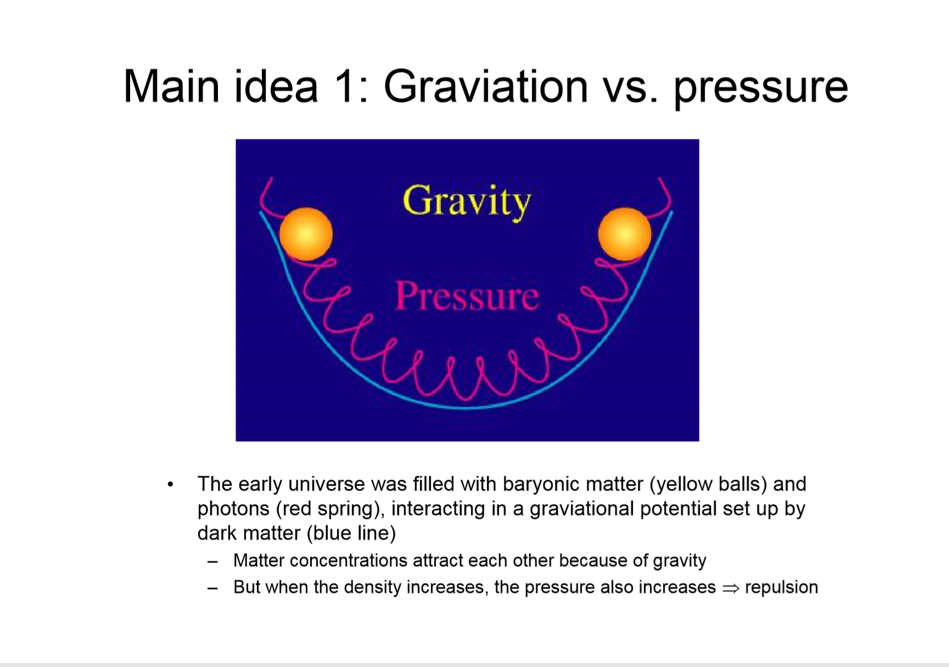
Notes:
Drawing on borad

Slide 25
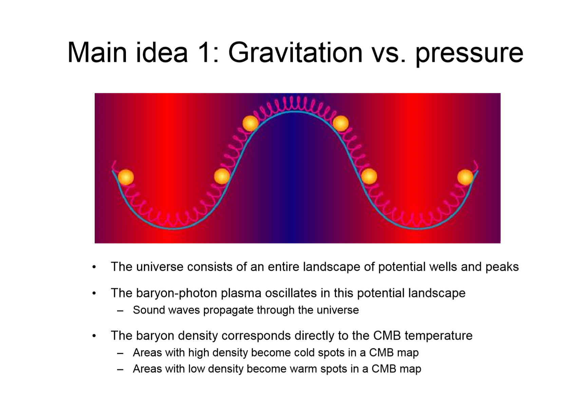

Slide 27
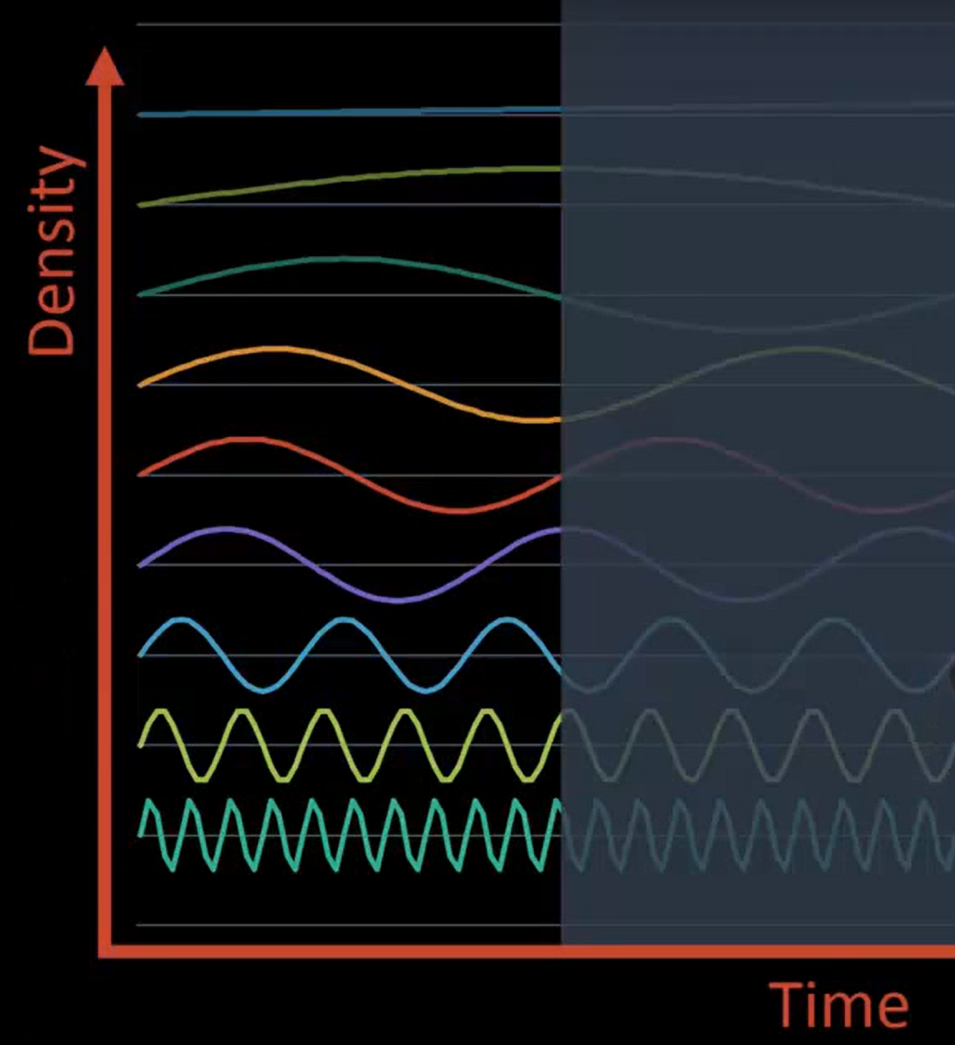
Acoustic waves
As previously we have showed that all the densities will bounce around, we will get the densities fluctuating over time. And when suddenly CMB was emitted, then the acoustic waves would remain their amplitude at that time. And they will form harmonics, thus creating the peaks in the angular power spectrum.
Notes:
As you can see, with some of the fourier analysis skills and some huge data observed and analyzed with the help of FFT, we are able to decompose all these signals and find some interesting clues of our early universe We can CMB and fourier analysis on many other prospective, such as predicting the curvature of our universe, proving existence and understanding the behavior of dark matters, predicting weak gravitational lensing and so on. Fourier analysis gives us huge power in understanding our univese better.

Slide 28
References
Heckbert, Paul. “Fourier Transforms and the Fast Fourier Transform (FFT) Algorithm”
Stein, Elias & Rami Shakarchi. Fourier Analysis: An Introduction
Shoup, Victor. “Polynomial arithmetic and the FFT”

